Slide 1
Career Services & Opportunities for Math Majors
University of Pittsburgh Career Center
Emily Bennett
Science, Tech & Math Career Consultant

Slide 2
Career Services
Career Consultant,
Science, Tech, Math & Stats
Employment Development Specialist, STEM
Resumes/Cover letters
LinkedIn
Interviewing
Exploring types of work
Career assessments
Internship/Job search strategies
Salary negotiation
Networking
Graduate school options
Engages with employers for events, branding opportunities
Career Fairs/information sessions
On-campus interviewing
Shadowing
Networking
To Be Determined
Jeff Porter, M.A.

Slide 3
Availability (until replacement is hired)
Experiential learning (internships, research, volunteer, etc.)
30-minute appointments via in-person, Zoom, or phone
Schedule through Handshake
Call the front desk at 412-383-4473
Email intern@pitt.edu
20-minute, first come, first served appointments (200 WPU)
Internship Team
Monday-Thursday, 11-1pm
Any Career Consultant
Monday-Friday, 11am-3pm
Career exploration & full-time job search
20-minute, first come, first served appointments (200 WPU)
Any Career Consultant
Monday-Friday, 11am-3pm

Slide 4
The Internship Prep Program is a team of internship specialists who can assist you in your internship search. Meet with them 1:1 or attend their workshops to become a competitive applicant, meet employers, and more!
To learn more about their services and programs, please visit www.internships.pitt.edu.

Slide 5
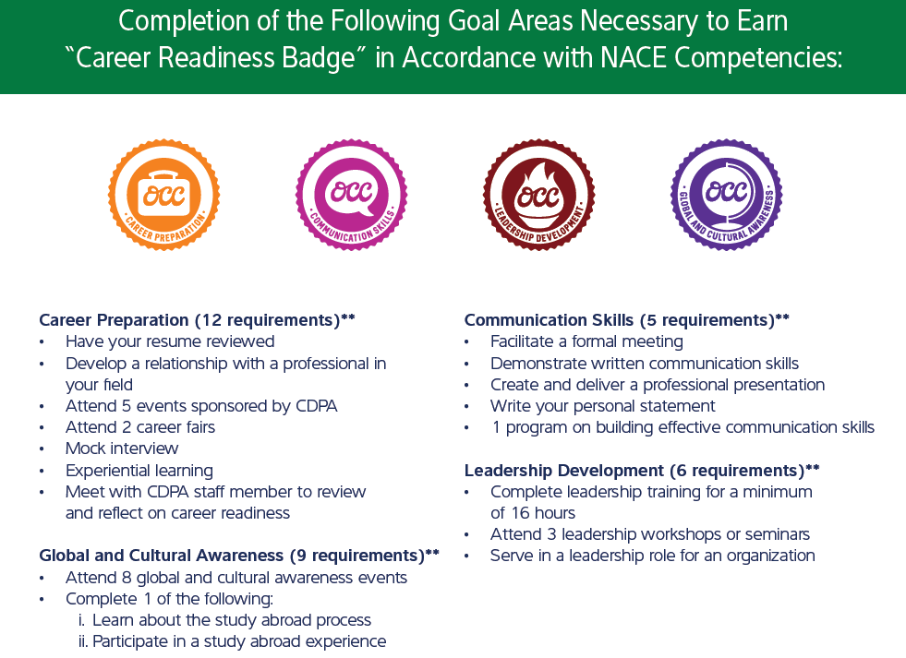
For more information, visit www.occ.pitt.edu.

Slide 6
Your hub for everything college to career!
[
Receive personalized career info
⁶
^{Manage your profile}
^{Log-in at my.pitt.edu}
^{to get started!}
@
^{Apply to jobs and internships}
ª
^{Connect with employers}
^{þ}
^{Sign up for career events}

Slide 7
Additional Career Center Resources
Virtual mock interviewing software
Also includes salary negotiation advice/training
Career assessment new to Pitt, but may be familiar from high school
Measures values, interests and aptitude to match with occupations
Need code to take for free; fill out survey here: https://pitt.co1.qualtrics.com/jfe/form/SV_cHZBew1PXkobbRb
Opportunities abroad + country guides
H1B database of companies

Slide 8
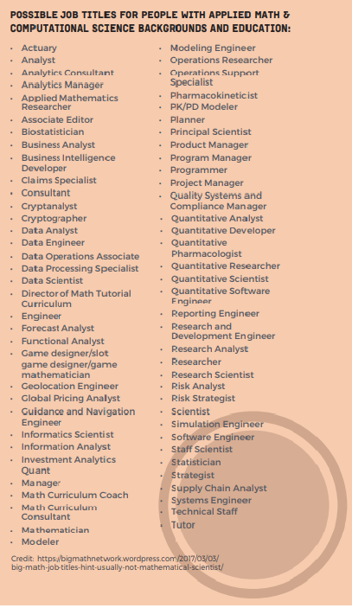
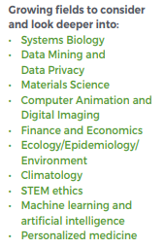
Exploring Careers in Industry
http://www.maa.org/careers/career-profiles
http://www.siam.org/careers

Slide 9
Career Data for Mathematics Majors
Career Paths:
Job Titles:
Popular Career Options:
Academics & Teaching
Actuarial Science & Accounting
Business Management
Computing
Engineering
Investment Analysis
Law
Medicine & Life Sciences
Military & Public Service
Physical Science
Sales & Marketing
K-12 Teaching
Actuarial Science
Computer Science
Operations Research
Biomathematics
Cryptography
Finance
Data Science
Financial/Business Analyst
Quantitative Analyst
Software Developer
Research Associate
Math Teacher
Actuary
Systems Analyst
Design & Analysis Engineer
Consultant
Pitt alumni have careers at:
Booz Allen Hamilton
Geico
Highmark
IBM
KPMG
Allstate
BNY Mellon
Federal Reserve
Census Bureau
Boeing
Epic Systems
McKinsey & Company
Aon Hewitt
PriceWaterhouseCoopers
Natural Bureau of Economic Research
Teach for America
Salary:
Projected: $63,316 median for 2021 graduates
www.naceweb.org

Slide 10
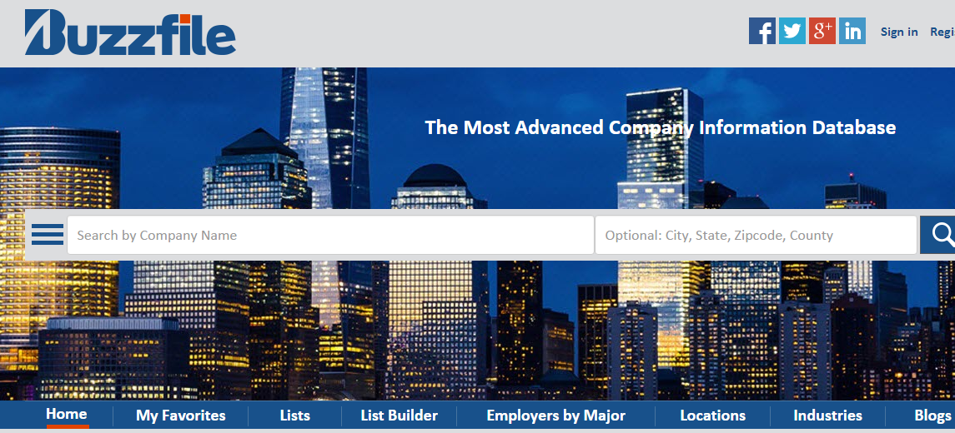
https://www.buzzfile.com/Home/Basic

Slide 11
Job & Internship Search Checklist
Feel good about your resume
Consider creating multiple versions for different industries/roles
Have it reviewed by the Career Center or trusted friend, advisor, mentor
Upload it and make it public on Handshake
Create a target list of employers & geographic regions
Explore Handshake, Buzzfile & math related websites
Reflect on companies you’re familiar with and consider math-related roles, i.e. PetSmart- Data Scientist Internship
Create ‘job search agents’ on their websites
Apply to openings you find on job related websites like Handshake, as well as on company sites
Average amount of applications to land full-time job = 125
Follow-up with recruiters, Pitt alumni, etc. so you don’t stay in the general applicant pool forever

Slide 12
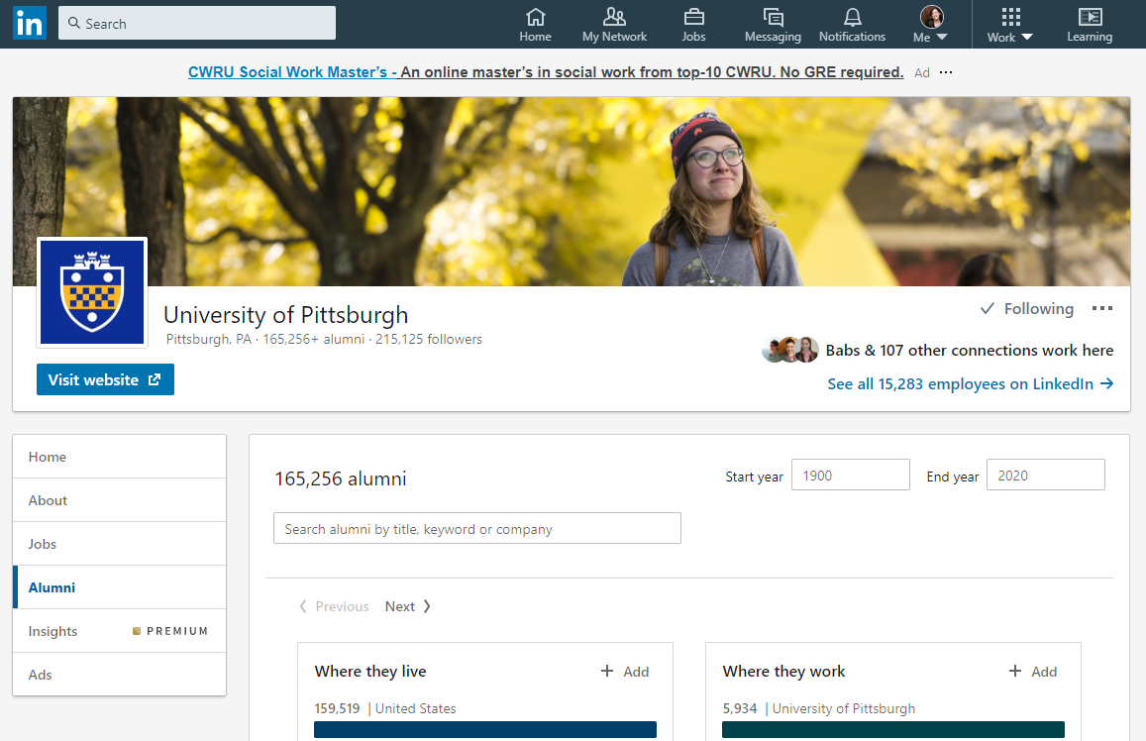
Making Connections: Employers & Alumni

Slide 15
Before attending the fair – in Handshake you MUST
Make sure your profile is up to date with your major and class year – contact the registrar if not
Upload a current resume and make it public
Make sure you have the work authorization field filled out – you can decline to choose, but declining counts as filled out

Slide 16
Virtual Sessions: 1:1 & Group

Slide 17
Career Fairs: Prep
Feel good about your resume
Upload your resume and make it public
Schedule your sessions in advance
Practice your elevator pitch
Conduct company research on Handshake, LinkedIn, company websites
Keep a notebook and your resume available
Select attire to look your best

Slide 18
Questions?
University of Pittsburgh Career Center
Emily Bennett, STEM Career Consultant
emb108@pitt.edu
www.careers.pitt.edu

